Slide 1
Support Vector Machines in Python
Identifies the optimal line or hyperplane that best separates classes.

Slide 2
Contents
01
02
Introduction to Support Vector Machines
Concept of Hyper Planes
03
04
Linear Separators
Mathematical Approach to Linear SVM
05
06
Kernel Function
SVM in Python

Slide 3
Introduction to Support Vector Machines
Support Vector Machines (SVM’s) is a relatively new learning method generally used for classification problem.
Although the first paper dates way back to early 1960’s it is only in 1992-1995 that this powerful method was universally adopted as a mainstream machine learning paradigm
The basic idea is to find a hyper plane which separates the d-dimensional data perfectly into its classes. However, since training data is often not linearly separable, SVM's introduce the notion of a “Kernel-induced Feature Space" which casts the data into a higher dimensional space where the data is separable.

Slide 4



What is a Hyper Plane
In two dimensions, a hyper plane is defined by the equation:
This is nothing but equation of line.
The above equation can be easily extended to the p-dimensional setting:
In short,
In p > 3 dimensions, it can be hard to visualize a hyper planes.

Slide 5



Separating a Hyper Plane
Binary classification can be viewed as the task of separating classes in feature space:
Fig. 01: Binary Classification
Here line separates data into two parts

Slide 6
Linear Separators
The objective in SVM is to find optimum separator
Fig. 02: Linear Separators
Which of the linear separators is optimal?

Slide 7

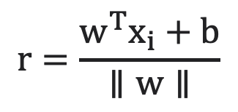
Classification Margin
Distance from case x_{i} to the separator is
Here || w || is length of a vector given by sqrt(sum(W^2))
Cases closest to the hyper plane are Support Vectors
Margin ρ of the separator is the distance between support vectors
r

Slide 8
Maximum Margin Classification
The objective is now to maximize the margin ρ of the separator
The focus is on ‘Support Vectors’
Support vectors determine the position of the hyperplane; non-support vectors do not affect the final solution once the optimum is reached.

Slide 9
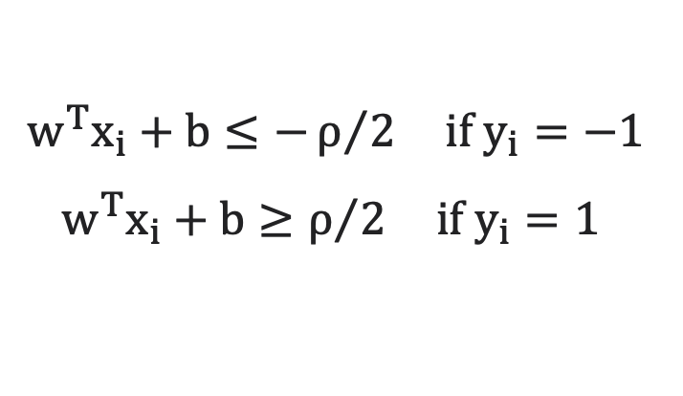

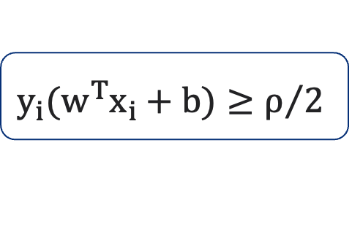
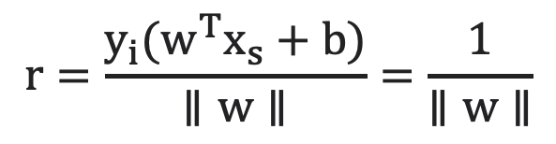
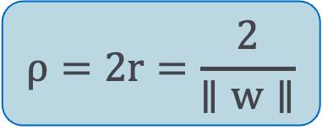
Mathematical Approach to Linear SVM
Let training set be separated by a hyper plane with margin ρ. Then for each training observation
For every support vector x_{s} the above inequality is an equality
After rescaling w and b by ρ/2 in the equality, we obtain that distance between each x_{s} and the hyperplane is
Margin can be expressed through(rescaled w and b as:)

Slide 10
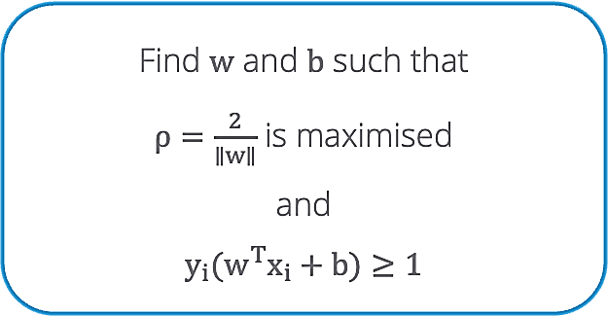
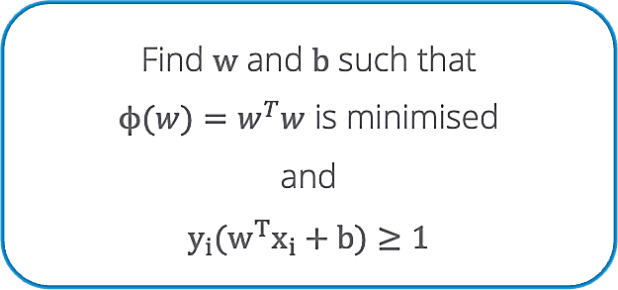
Mathematical Approach to Linear SVM
Quadratic Optimization problem is:
which can be reformulated as:

Slide 11
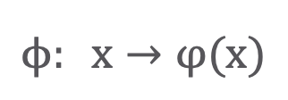
Non-Linear SVMs – Feature Spaces
General idea: The original feature space can always be mapped to some higher-dimensional feature space where the training set is separable

Slide 12
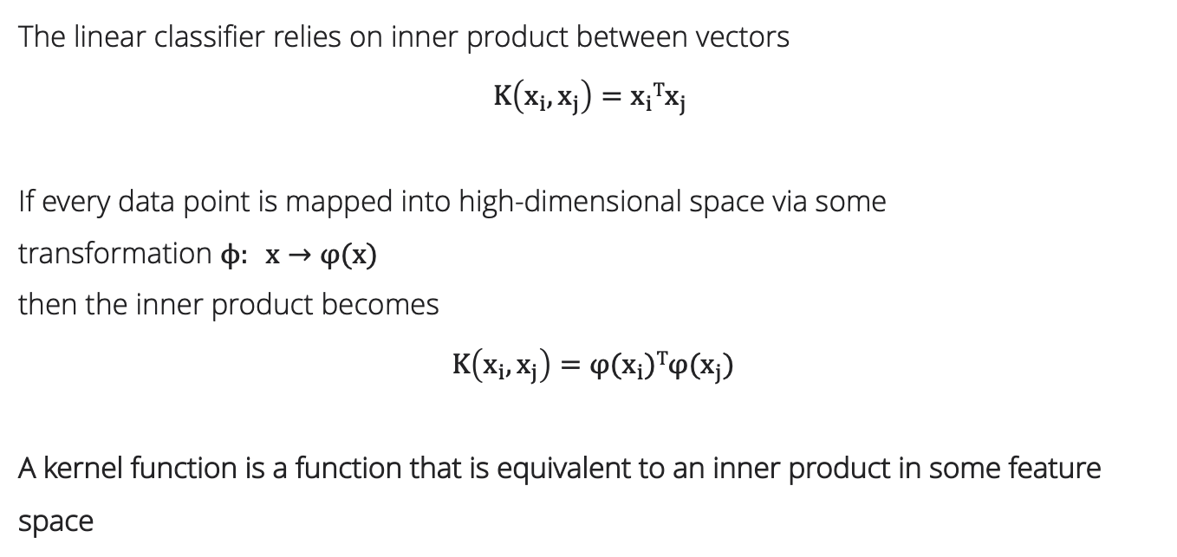

The "Kernel Trick"
The linear classifier relies on inner product between vector
If every data point is mapped into high-dimensional space via some transformation
then the inner product becomes:
A kernel function is a function that is equivalent to an inner product in some feature space
One-line definition of Kernel:
A kernel function computes similarity between data points in an implicit higher-dimensional feature space, avoiding the need to transform the data explicitly.

Slide 13
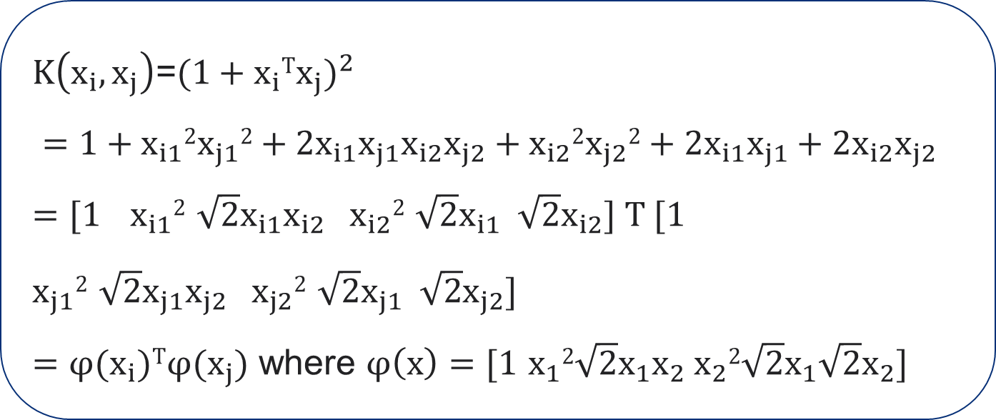
The "Kernel Trick"
Example:
2-dimensional vector x = [ x₁ x₂ ] ;
Let K(xᵢ, xⱼ) = (1 + xᵢᵀ xⱼ)²
Need to show that K(xᵢ, xⱼ) = φ(xᵢ)ᵀ φ(xⱼ)
Thus, a kernel function implicitly maps data to a high-dimensional space
(without the need to compute each φ(x) explicitly).

Slide 14




Examples of Kernel Functions
Linear
Mapping φ
Polynomial of power ρ
Gaussian (Radial basis function)

Slide 15
SVM in Python
# Model fitting
svclassifier = SVC(kernel='linear',probability=True)
svclassifier.fit(X_train, y_train)
# Predicted Probabilities
predprob_test = svclassifier.predict_proba(X_test)
svc() trains a support vector machine.
kernel= specifies the kernel type to be used in the algorithm‘(linear’, ‘poly’, ‘rbf’, ‘sigmoid’, ‘precomputed’).
predict_proba() returns predicted probabilities for the test data.

Slide 16
KEY TAKEWAYS
In this session, we learnt about Support Vector Machines:
Support Vector Machines
  SVMs find a hyper plane which separates the d-dimensional data perfectly into its classes
  Since training data is often not linearly separable, SVM's introduce the notion of a “Kernel-induced Feature Space" which casts the data into a higher dimensional space where the data is separable
SVM in Python
Library “sklearn.svm" has SVC() that trains a support vector machine
The function takes arguments to specify whether SVC() is to be used for classification or regression; if probabilities are to be returned and which kernel to use for training and predicting

